Slide 1
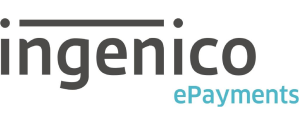
Your first journey in Git
Carlos Da Silva, Adrien Clerbois
Ingenico ePayments

Slide 2

Our journey to source control management

Slide 3

Our journey : the begin
History
Branching
1
More
Version Control
Commands

Slide 4
More
2
Branching & Merging
Git Flow
A minimal Configuration
Git on Visual Studio
Integration with TFS
Tools

Slide 5
Tools
Do it, play
GitHub
Thrid party tools
4

Slide 6

Keep in mind
GIT IS IN BACKLOG OF THE TOOLS TEAM
FOR THE MOMENT DO NOT USE GIT IN INGENICO PROJECTS

Slide 7
Introduction to version control

Slide 8
Introduction to version control
« Git is an example of Version Control »
Version control is a system that records changes to a file or set of files over you can recall specific versions later.
It allows you to :
Revert files to previous state
Revert entire project back to previous state
Compare changes over time
See who modified what? And much more…
It means if you screw things up or lose files, you can easily recover.
.

Slide 9
Other popular version control systems
TFVC (TFS classic)
Concurrent Versions System (CVS)
Perforce
Mercurial
Bazaar
All the other ones you know…
.

Slide 10

Forget TFS

Slide 11
Git isn’t an evolution of TFS
rcs
cvs
svn
git

Slide 12

Introduction
Notes:
Git is a version control system (VCS) for tracking changes in computer files and coordinating work on those files among multiple people. It is primarily used for software development, but it can be used to keep track of changes in any files. As a distributed revision control system it is aimed at speed, data integrity, and support for distributed, non-linear workflows.
Git was created by Linus Torvalds in 2005 for development of the Linux kernel, with other kernel developers contributing to its initial development. Its current maintainer is Junio Hamano.
As with most other distributed version control systems, and unlike most client–server systems, every Git directory on every computer is a full-fledged repository with complete history and full version tracking abilities, independent of network access or a central server/
Like the Linux kernel, Git is free software distributed under the terms of the GNU General Public License version 2.

Slide 13
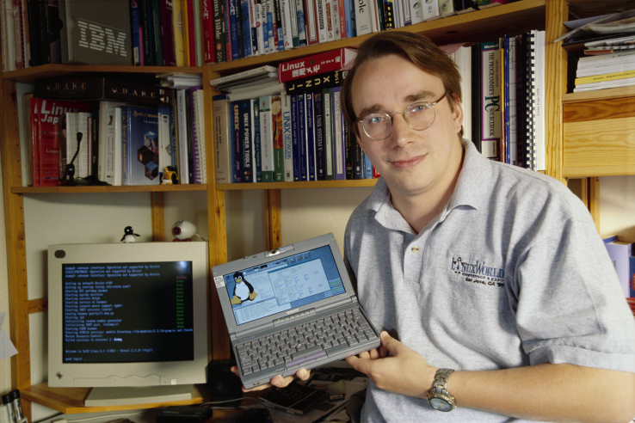
History
Designed and developed by Linus Torvalds (2005)
Essentially for Linux kernel dev
Created as a replacement when BitKeeper suddenly became "unavailable"
Distributed under GNU General
Public License version 2

Slide 14
Git : The big picture
Uses cases :
Individual Development
Collaborative Development
Offline Usage
Why Git ?
Everything is local (full history tree available offline)
Everything is fast

Slide 15
Git Workflow : the three states
« Something very important »
In a Git repository your file can reside in three main states :
Modified / Untracked
Staged
Committed
What does this mean ?

Slide 16
Git Workflow : the three states
Local Operations
You modify in your working directory
Working
directory
Staging
area
Git directory
(repository)

Slide 17
Git Workflow : the three states
Local Operations
You stage the files, adding snapshots of the to your staging area.
Working
directory
Staging
area
Git directory
(repository)
Stage files

Slide 18
Git Workflow : the three states
Local Operations
You do a commit that stores snapshot permanently to your Git directory
Working
directory
Staging
area
Git directory
(repository)
Stage files
Commit

Slide 19
Git Workflow : the three states
Local Operations
Then, you can retrieve any existing version, make changes, stage them and commit
Working
directory
Staging
area
Git directory
(repository)
Get the project content
Stage files
Commit

Slide 20
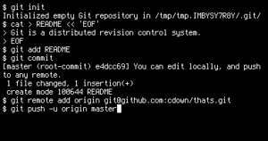
Meet Git
Notes:
It was – and still is - the time of Agile and DevOps.
We had to formulate a DevOps strategy for our entire organization.
But what is DevOps? It can mean radically different things for different people!

Slide 21
Identity
git config --global user.name "ACL"
git config --global user.email "acl@ogone.be"
Editor
git config --global core.editor "path to VS Code"
First time git setup - Let's get to know Git
See
git config --list
Notes:
We quickly realized that our DevOps transformation will have broad organizational impact.
Every DevOps conversation needs to focus on people, processes and tools equally, otherwise the transformation will fail.

Slide 22
Commands

Slide 23
Create a new repository
Git Init : Create an empty Git repository or reinitialize an existing one
git init

Slide 24
Working with a repository
Clone a repository into a new directory
git clone [url]
Update local tree with changes in remote repository
git fetch origin
Update local tree and merge changes with local branch
git pull origin
Send changes to the remote repository
git push origin

Slide 25
Get Git commit history
You can study repository history using
git log
You can see last ‘p’ (p is a number) commits
git log -n p

Slide 26
Command : Check status
Git-status : Show the working tree status
git status

Slide 27
Compare changes over time
See changes in a commit
git show [commit_ID]
And compare two commits using
git diff [commit1_ID] [commit2_ID]

Slide 28
Add
Put files in stage
git add [filename]
Add all files altered, added & deletetion
git add --a

Slide 29
Navigating the tree
Go to a specific commit
git checkout [commit_ID]
Go to a specific branch
git checkout [branch_name]
Go to a specific tag
git checkout [tag_name]

Slide 30
Commit work
Commit staged files
git commit –m "Commit message"

Slide 31
Add Tags
Specific points in history as being important
git tag –m "Commit message"

Slide 32
Reset, revert, undo mistakes
Undo everything!
git reset HEAD~1 --hard
Undo a single file
git checkout --<filename>
Rollback
git revert <commithash>

Slide 33
Branching & Merging
Open your eyes

Slide 34
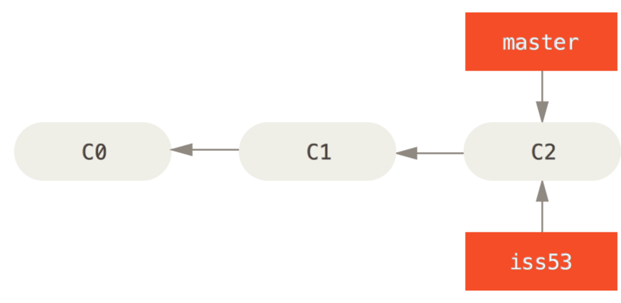
Start a new branch
> git branch iss53
> git checkout iss53
Switched to branch 'iss53'

Slide 35
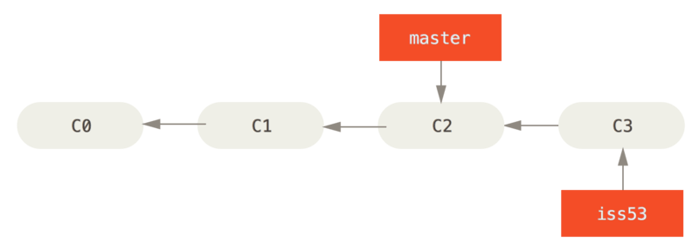
Work on my new branch
> git commit –m "Added some more readme crap"
[iss53 f38e672] Added some more readme crap!
1 file changed, 3 insertions(+), 1 deletion(-)

Slide 36

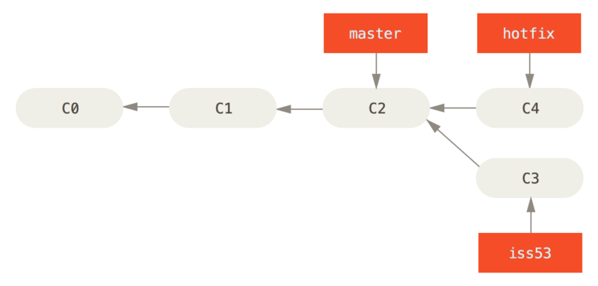
Houston we have a problem!
> git checkout master
Switched to branch 'master'
> git branch hotfix
> git checkout hotfix
Switched to branch 'hotfix‘
Work… Work… Work…
> git commit –m "Killed the bug!!!"
[hotfix 3b5b0a5] Killed the bug!!!
1 file changed, 3 insertions(+), 1 deletion(-)

Slide 37
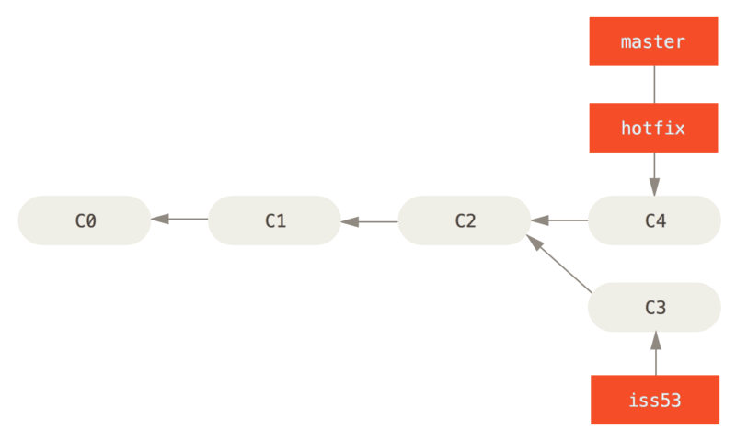
The fast forward
> git checkout master
Switched to branch 'master'
> git merge hotfix
Updating a66356d..3b5b0a5
Fast-forward
readme.txt | 4 +++-
1 file changed, 3 insertions(+), 1 deletion(-)
Notes:
Fast forward can be avoided by passing -no-ff to the merge command! Usefull to keep a good visual tree

Slide 38
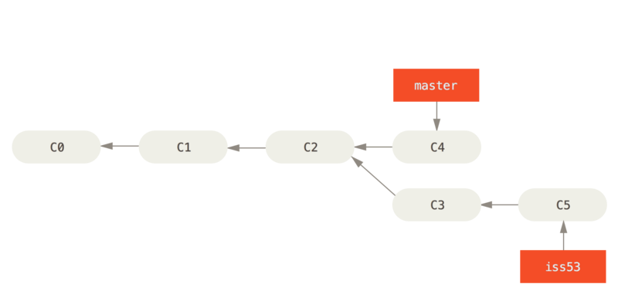
Now that the bug is gone
> git branch -d hotfix
Deleted branch hotfix (was 3b5b0a5).

Slide 39
Let’s complete iss53
> git checkout iss53
Switched to branch 'iss53‘
Work… Work… Work…
>git commit -m "completed my work"
[iss53 7ddb8c7] completed my work
1 file changed, 2 insertions(+), 1 deletion(-)

Slide 40
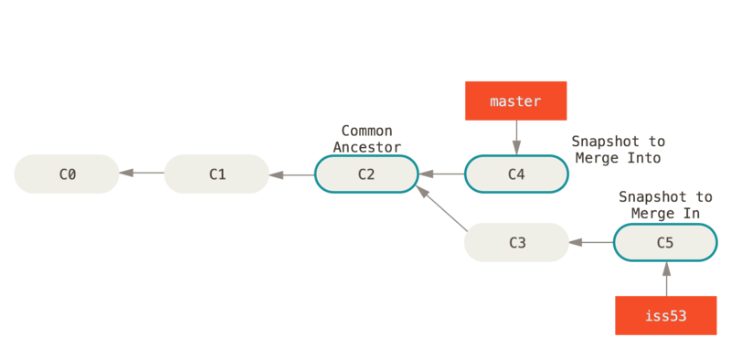
Where are we before the merge?

Slide 41
Merge… Huh ho!
> git checkout master
Switched to branch 'master'
> git merge iss53
Auto-merging readme.txt
CONFLICT (content): Merge conflict in readme.txt
Automatic merge failed; fix conflicts and then commit the result.
> git mergetool
Merging:
readme.txt
Normal merge conflict for 'readme.txt':
{local}: modified file
{remote}: modified file
Hit return to start merge resolution tool (vsdiffmerge):
Notes:
[diff]
tool = vsdiffmerge
[difftool]
prompt = true
[difftool "vsdiffmerge"]
cmd = \"C:\\Program Files (x86)\\Microsoft Visual Studio 14.0\\Common7\\IDE\\vsdiffmerge.exe\" \"$LOCAL\" \"$REMOTE\" //t
keepbackup = false
trustexistcode = true
[merge]
tool = vsdiffmerge
[mergetool]
prompt = true
[mergetool "vsdiffmerge"]
cmd = \"C:\\Program Files (x86)\\Microsoft Visual Studio 14.0\\Common7\\IDE\\vsdiffmerge.exe\" \"$REMOTE\" \"$LOCAL\" "$BASE" \"$MERGED\" //m keepbackup = false
trustexistcode = true

Slide 42
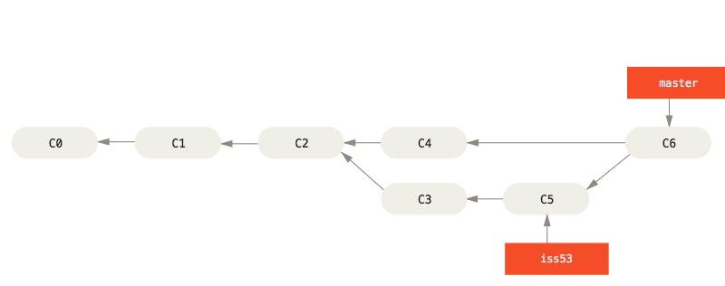
Super! Merge done!
> git add readme.txt
> git commit -m "Merge iss53 to Master"
[master 70215f4] Merge iss53 to Master

Slide 43
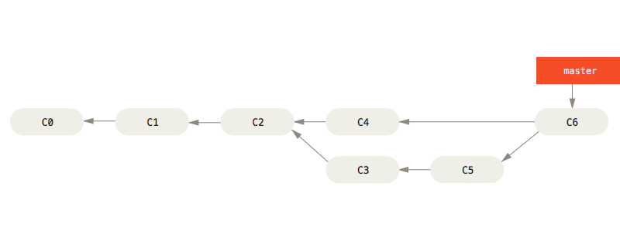
Cleanup
> git branch -d iss53
Deleted branch iss53 (was 7ddb8c7).

Slide 44
Ignoring files

Slide 45
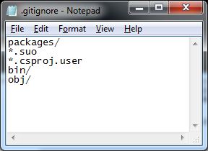
.gitignore
Add .gitignore file at the root of your workspace directory
Format :
https://git-scm.com/docs/gitignore

Slide 46
Git ignore resources
https://github.com/github/gitignore

Slide 47
Visual Studio

Slide 48
Demo

Slide 49
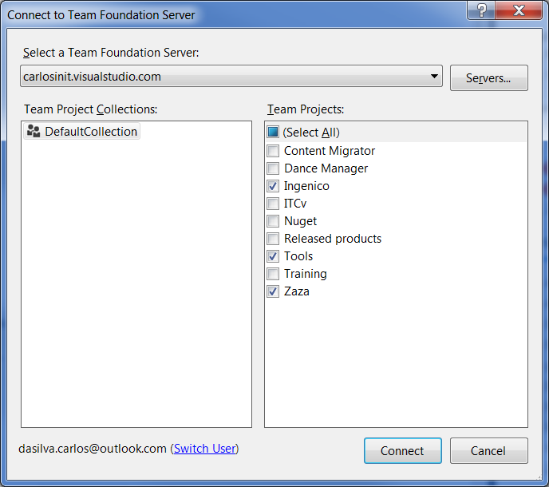
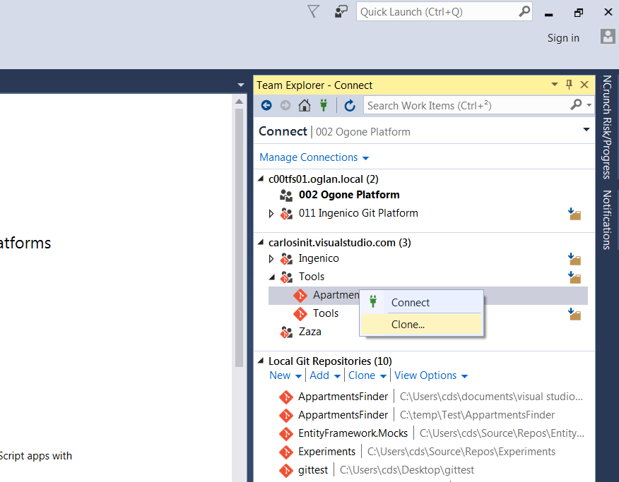
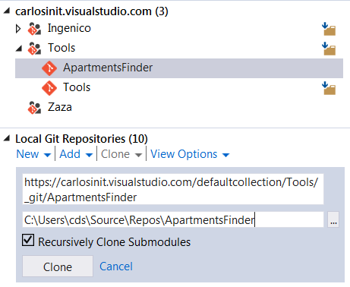
Clone an existing repository

Slide 50
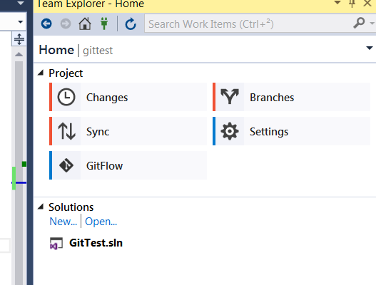
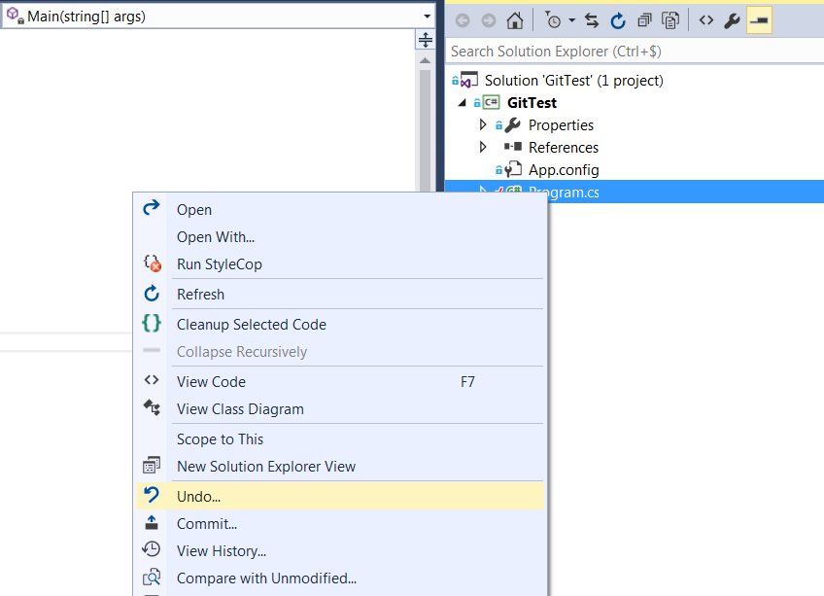
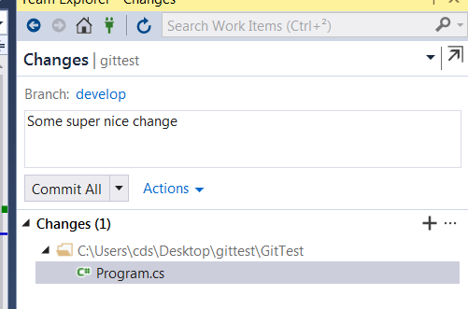
Commit / Undo

Slide 51
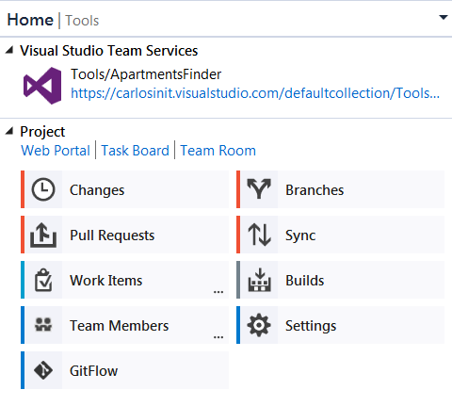
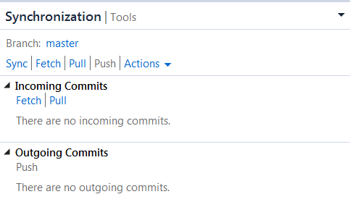
Push / Pull / Sync

Slide 52
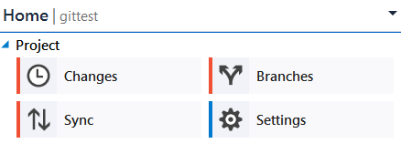
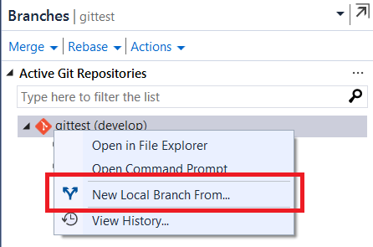
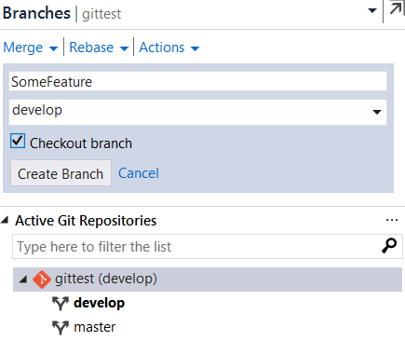
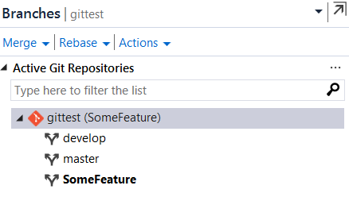
The branches

Slide 53
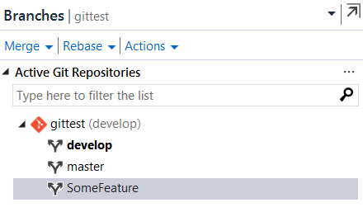
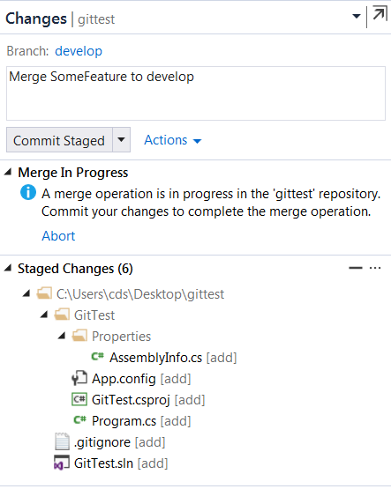
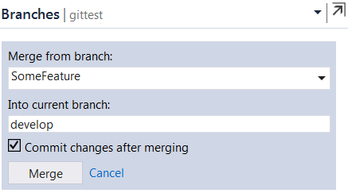
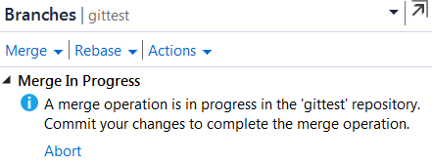
Merging all day…
Uncheck this

Slide 54
GitFlow

Slide 55
Master & Develop
Master = PROD
Develop integrates all features

Slide 56
Feature & Hot Fix
Feature
Starts from develop
Piece of functionality (often = US)
When done merged back to develop
Hot Fix
Starts from master
When done
Merged to master
Merged to develop

Slide 57
Release
Starts from develop
Fixes to the release happen here
When done
Merged to develop
Merged to master
Version tag is created

Slide 58
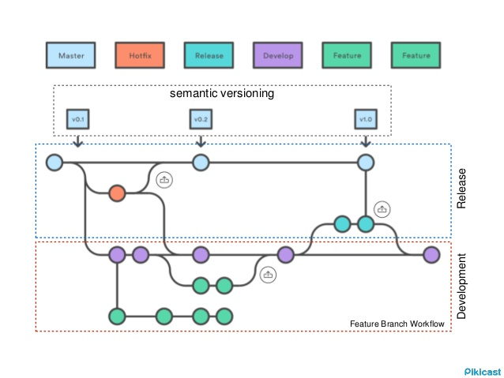
In a nutshell

Slide 59
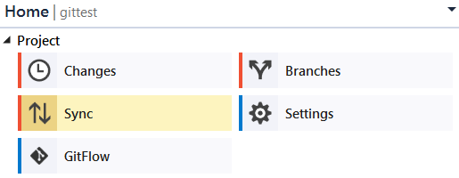
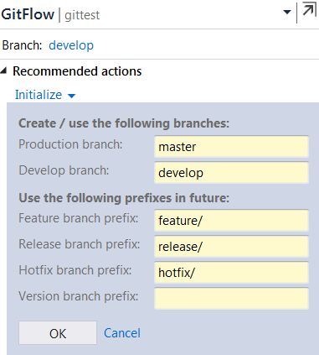
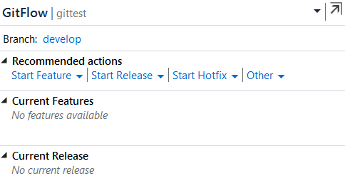
In VS

Slide 60
External tools

Slide 61

SourceTree
Altassian
Completely free
UI for advanced features
https://www.sourcetreeapp.com/

Slide 62

GitKraken
Axosoft
Free for non-commercial use
UI for advanced features
https://www.gitkraken.com/

Slide 63

GitHub

Slide 64
GitHub
https://github.com/
The biggest repository out there
Major open source projects
Microsoft is in there
https://github.com/dotnet/roslyn
https://github.com/aspnet/Mvc
https://github.com/aspnet/EntityFramework

Slide 65
Confusions of a TFS user
TFS Get latest version
TFS Get latest version
TFS Checkin
Git Clone
Git Pull
Git commit & Git push
Question 1
?
?
Question 2
Question 3
?

Slide 66

Hands on
Go to next level
bit.ly/git-try

Slide 67
Others resources
http://learngitbranching.js.org/

Slide 68
Thank you
Ingenico ePayments Training Chapters

